Slide 1
Online chat application

Slide 2
introduction
A chat application makes it easy to communicate with people anywhere in the world by sending and receiving messages in real time. With a chat app, users are able to receive the same engaging and lively interactions through custom messaging features, just as they would in person.
The Chat Application Using Django is developed using Python Django, HTML,CSS and JavaScript, This Chat App Django contains all the features of any chat app such as login, register functions and allows users to chat with anyone registered to the system.
A Chat App In Django contains similar user interface as a messenger application where all registered users are listed and you can chat with anyone.

Slide 3
Django
Django (/ˈdʒæŋɡoʊ/ JANG-goh; sometimes stylized as django)^{[6]} is a Python-based free and open-source web framework that follows the model–template–views (MTV) architectural pattern.^{[7][8]} It is maintained by the Django Software Foundation (DSF), an independent organization established in the US as a 501(c)(3) non-profit.
Django's primary goal is to ease the creation of complex, database-driven websites. The framework emphasizes reusability and "pluggability" of components, less code, low coupling, rapid development, and the principle of don't repeat yourself.^{[9]} Python is used throughout, even for settings, files, and data models. Django also provides an optional administrative create, read, update and delete interface that is generated dynamically through introspection and configured via admin models.

Slide 4
Pyhton
Guido van Rossum began working on Python in the late 1980s as a successor to the ABC programming language and first released it in 1991 as Python 0.9.0.[32] Python 2.0 was released in 2000 and introduced new features such as list comprehensions, cycle-detecting garbage collection, reference counting, and Unicode support. Python 3.0, released in 2008, was a major revision that is not completely backward-compatible with earlier versions. Python 2 was discontinued with version 2.7.18 in 2020.[33]
Python consistently ranks as one of the most popular programming languages.

Slide 5
Problem Statement:
To develop Meet up application to give information about the details of user with their interested sport.
This application will allow all users to send and receive the message by their friends. User can access this application anywhere and anytime using his or her System.

Slide 6
OBJECTIVE
The system handles multiple users, lists all users in a chatbox, and a conversation box.
The active conversation has a feature that automatically loads the new chat or message.
The system also has a login and registration.

Slide 7
Methodology
This project is made by using paython and django. The programming languages used for building the application are django.
The other commands required are:
pip install Django
pip install django-crispy-forms
python manage.py migrate
python manage.py runserver

Slide 8
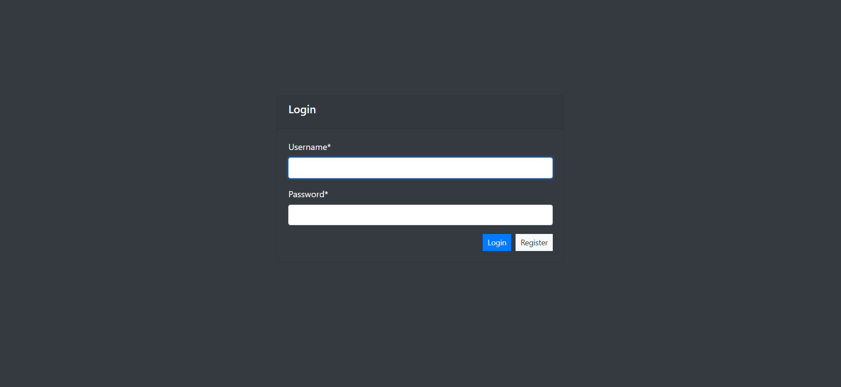
SNAP SHOT

Slide 9
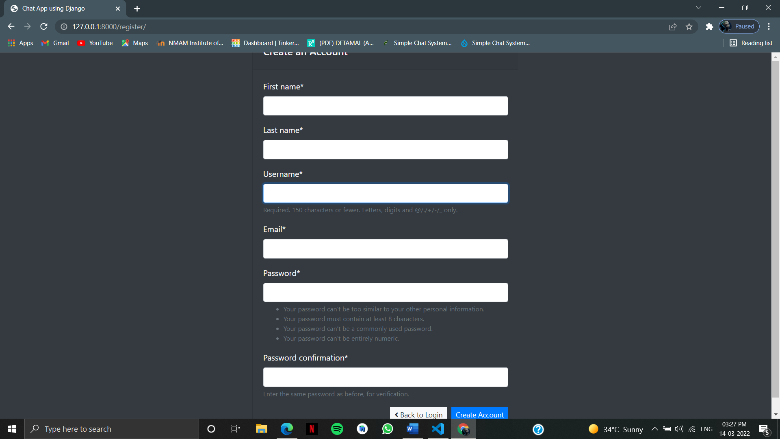

Slide 10
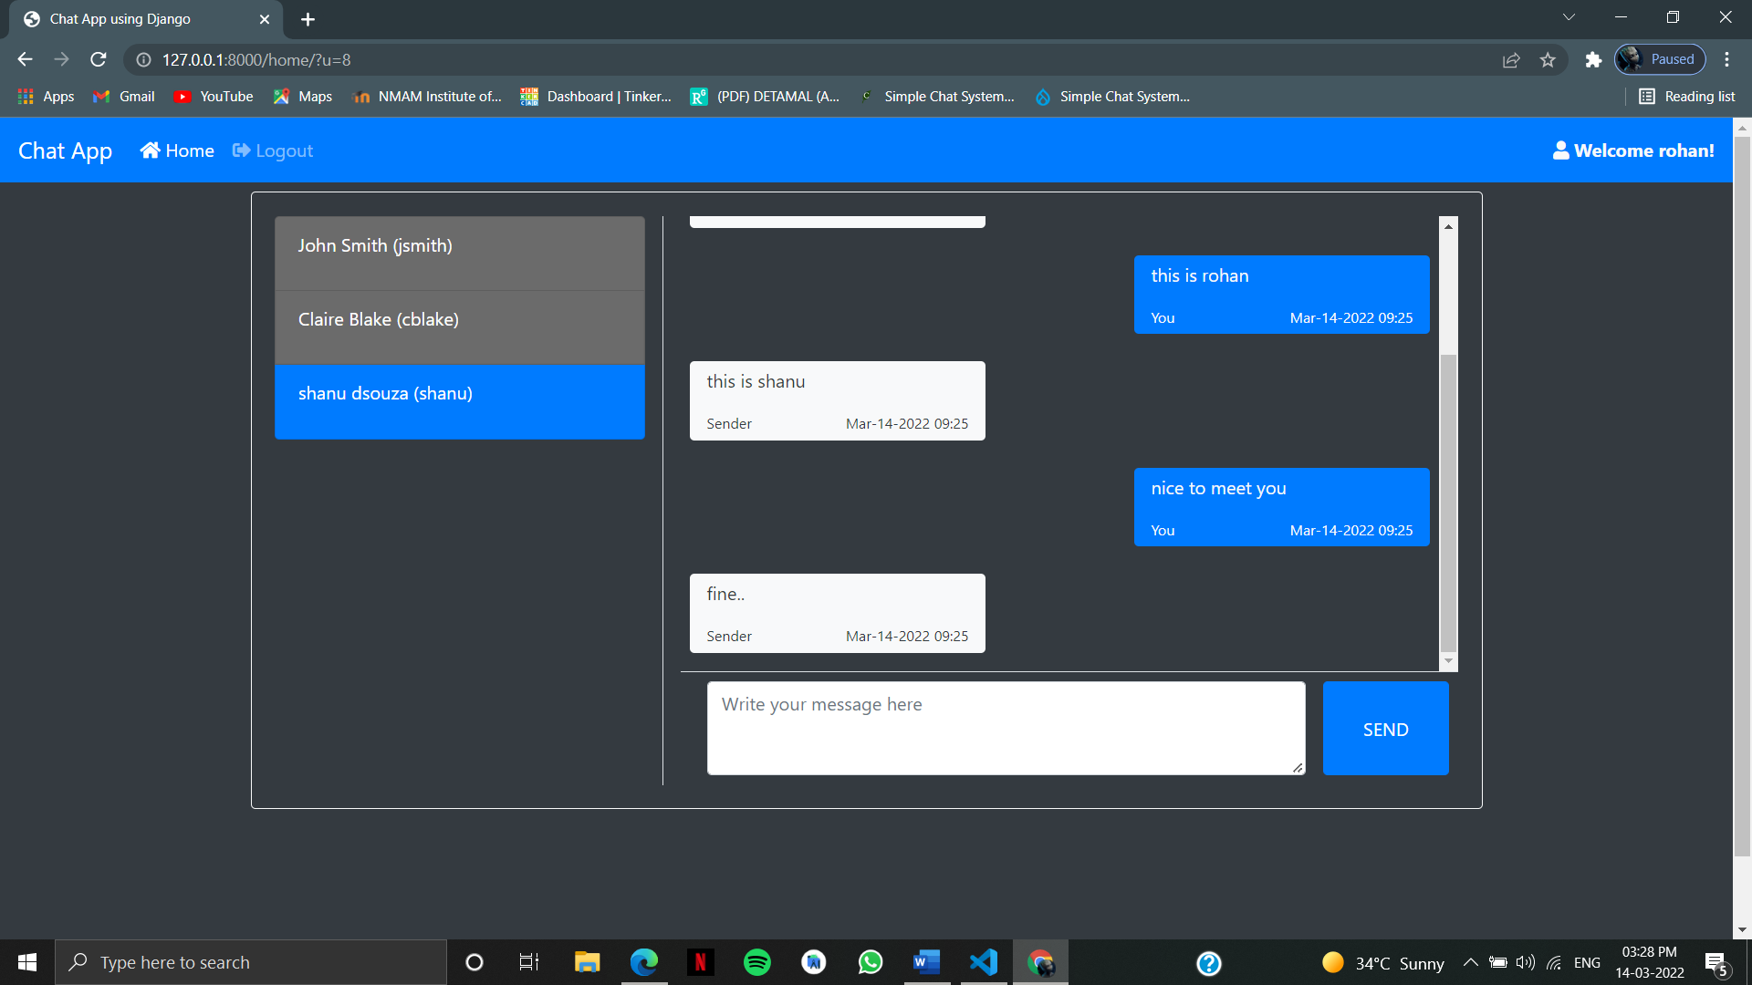

Slide 11
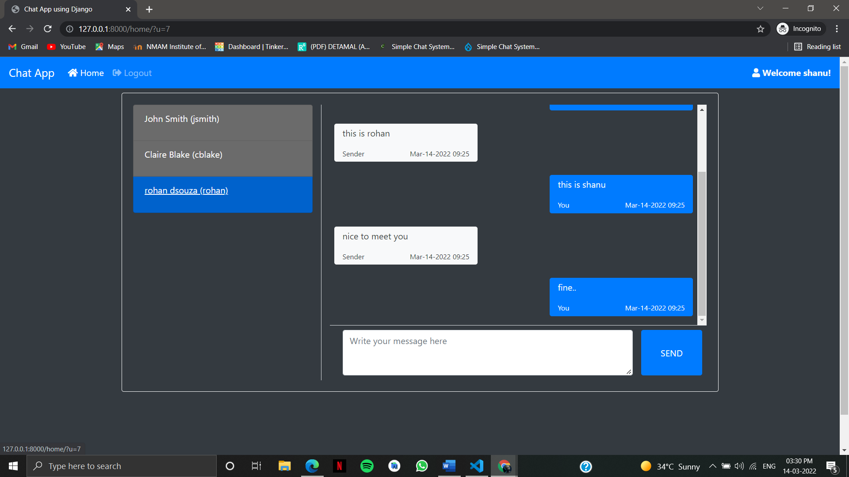

Slide 12
Conclusion
django as a full, open and free device platform, with its powerful function and good user experience rapidly developed into the most popular operating system.
This report gives an overview of the different challenges and issues faced in web app development The experience of developing an android app is quite challenging, motivating as well as satisfying.

Slide 13
REFERENCES
www.youtube.com
www.google.com
www.stackoverflow.com
https://ieeexplore.ieee.org/

Slide 14
THANK YOU

